Slide 1
Twitter Sentiment Analysis Using Language Network
Oct 9th, 2023
Zhonghui Cui (zhonghuc)
Yudi Chen(yudichen)
Weigen Chen(weigenc)

Slide 2
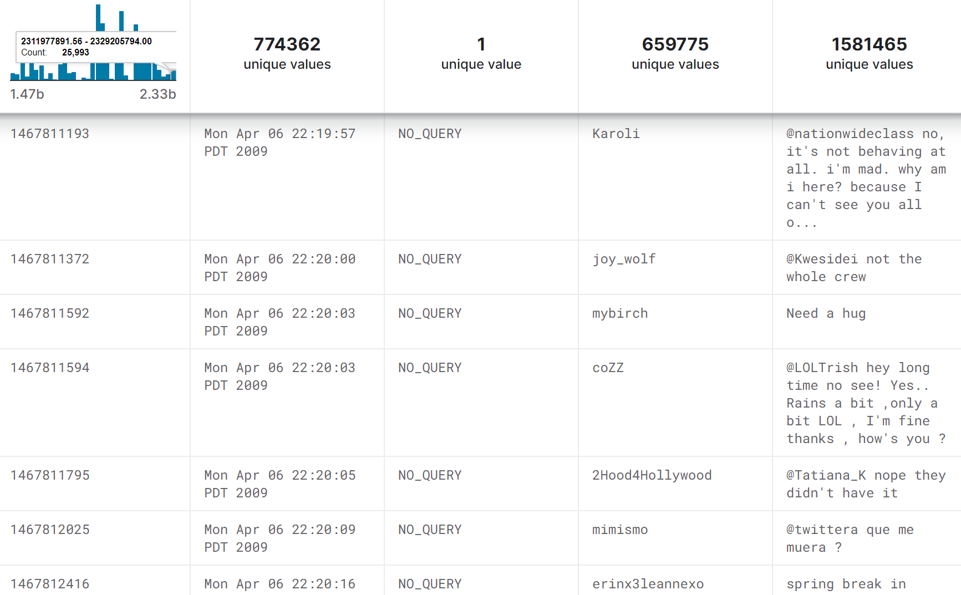
Project Overview
In the age of social media, understanding the sentiment behind posts on platforms like Twitter comments can provide valuable insights for various applications.
This project aims to investigate and analyze the language network consisting of sentiment expressing words, and then use it to categorize the sentiments expressed in Twitter posts.
We will explore the connections between words when it comes to expressing positive, neutral or negative sentiments and analyze sentiments in Twitter comments on a large scale.
Dataset of Twitter Posts to Be Analyzed

Slide 3
Approach
The node is a single word, including emotive words, noun words and adjective words. And we give each emotive word a score. (happy(5) sad(-5) excited(7)). The score shows whether sentiment of the words are positive or negative. The edge is the relationship between words.
Deconstruct each comment into a list of words. Match the list with the network, and generate a final score for the comment.
For example, A comment “I watched tragedy movie with my boyfriend last week. I am happy.”
The network include words “tragedy(-5)”, ”movie(do not have score)”, “happy(5)”, and the edge between “tragedy” and “movie” is “Common phrase”. So the “tragedy movie” is neutral phrase, and the whole comment is positive.
The input data include 16,000 posts extracted using twitter API.

Slide 4
Main Steps of the Approach
Find words and score them
Build the network
Extract twitter posts using twitter API.
Preprocess and Clean the dataset
lower casing, replacing URLs and emojis, removing comments with less than 2 words.
Build NLP model, develop algorithms for measuring word relationships.
Train and test

Slide 5
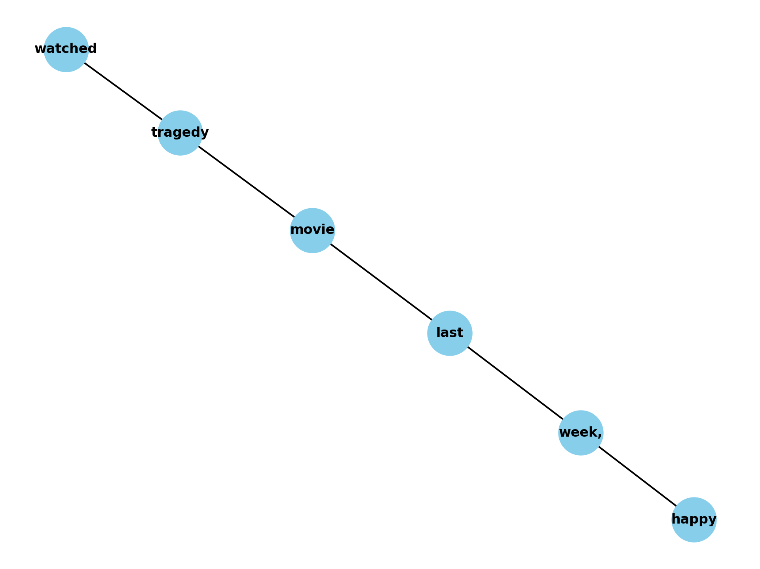
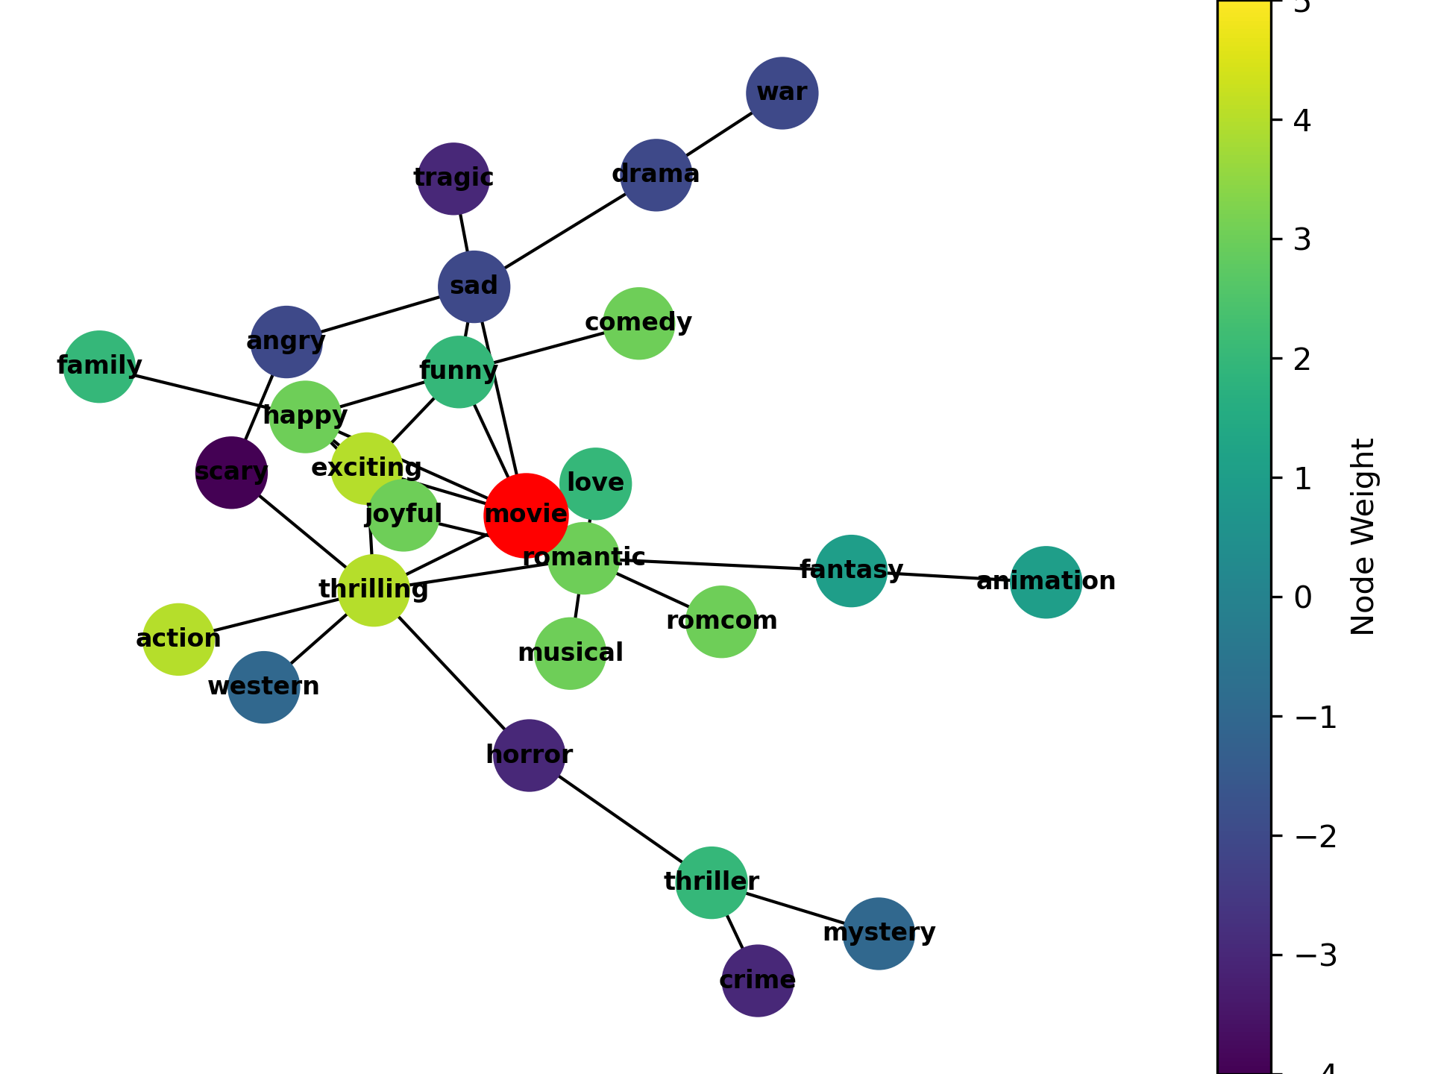
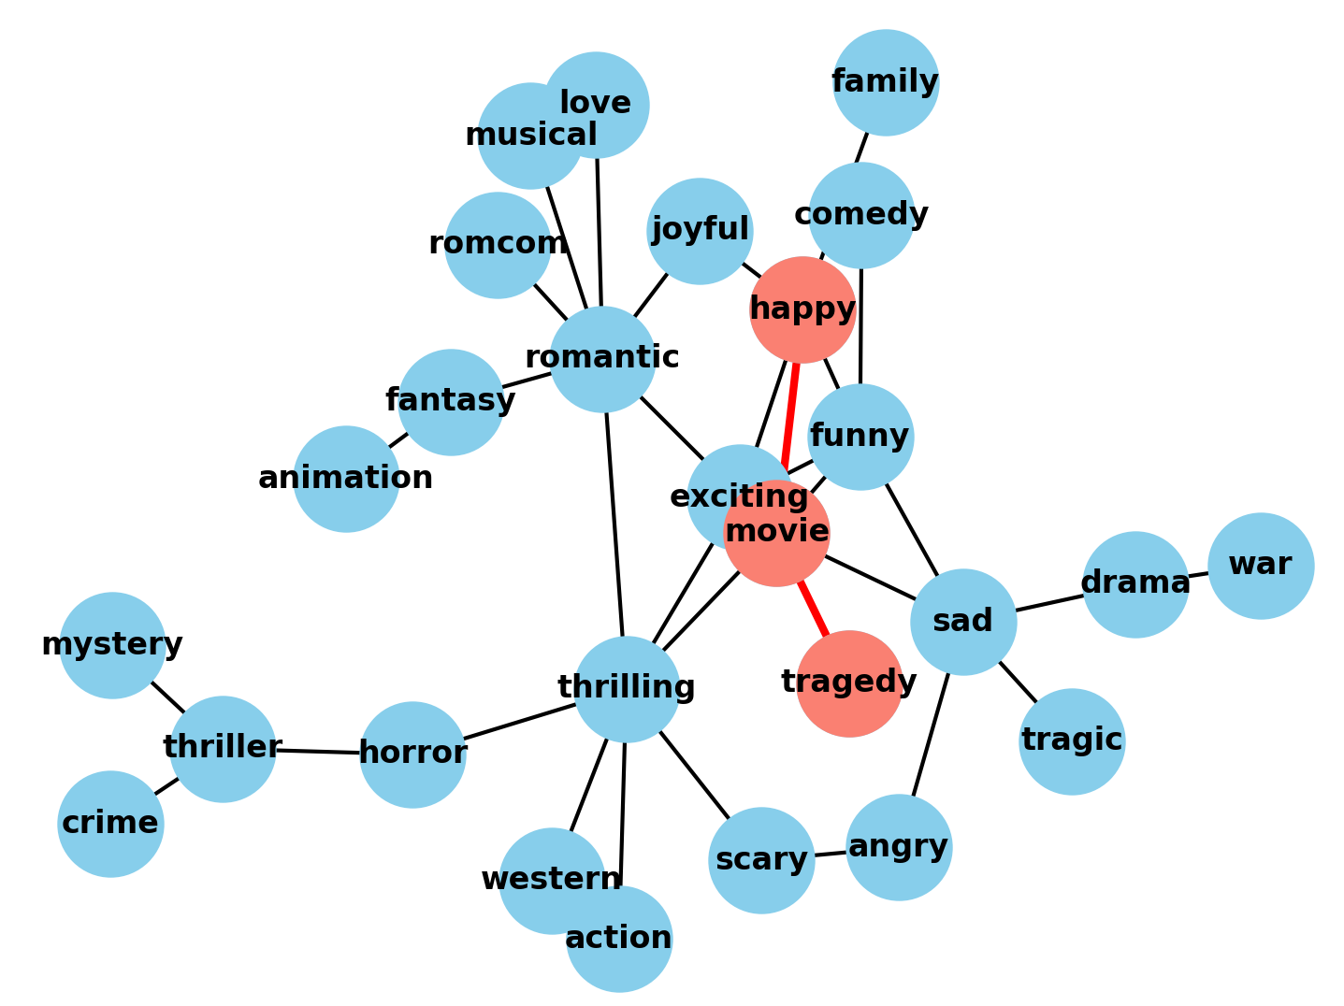
Preliminary Results
As of now, we have identify a set of twitter comments to be processed, and established an approach to analyze the collected data. We have already build
1. Our own sample analysis network and visualization of this network
2. Network of one comment
3. Exact match: match comment network in the analysis network

Slide 6
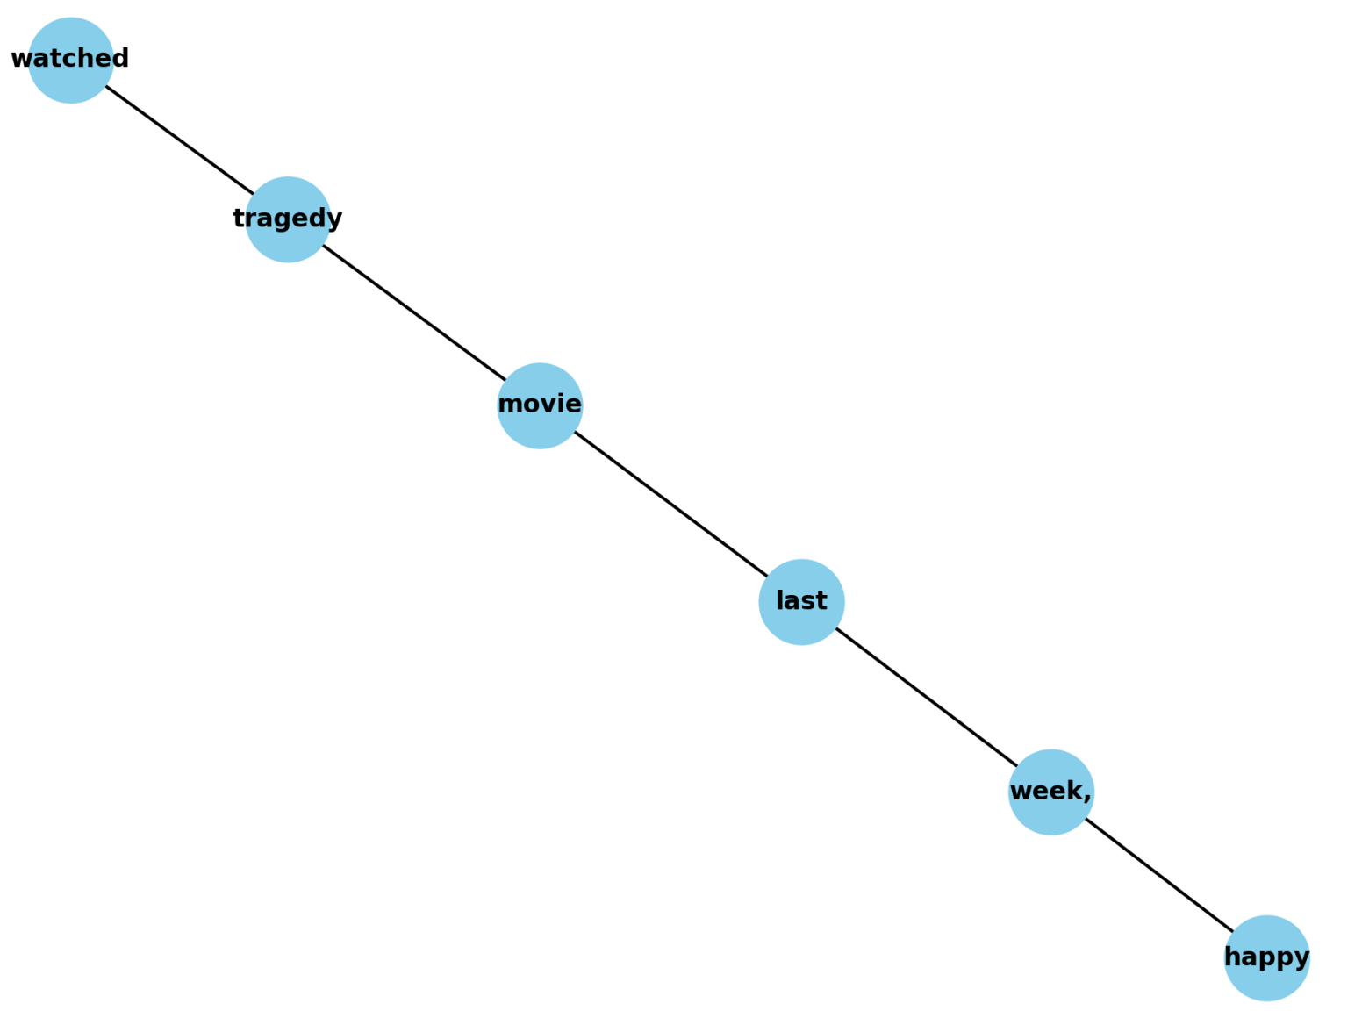
Future Development
1. Training dataset now we used is not good. We need to find more suitable dataset
2. Fuzzy matching and exact matching
3. How to deal with each comments. Delete some unnecessary words in the comment network

Slide 7
Timeline and Division of Labor
Timeline
Division of Labor
August 28 - September 25:
Project Kickoff, Topic Selection and Dataset Searching
September 26 - October 8:
Dataset Review and Preprocessing
October 9 - October 22:
Network Construction and Analysis
October 23 - November 5:
Algorithm Establishment for Comment Sentiment Analysis
November 6 - November 19:
Result Evaluation and Application Extension
November 20 - December 3:
Report Writing and Presentation Preparation
December 4 : Final Presentation
Weigen Chen: data collection and preprocessing, acquiring and cleaning linguistic datasets and building the network graph
Yudi Chen: working on the NPL model to implement sentiment analysis, developing algorithms for measuring word relationships to decide whether the comment is negative or positive
Zhonghui Cui: handling the creation of the user-friendly visualization tool, ensuring that the network's insights are easily accessible
All team members will collaborate on fine-tuning the network analysis and the machine learning model. Regular team meetings will facilitate communication and project progress tracking.

Slide 8
Conclusion and Plans
For this project, we are going to build a network of emotive words from the English language regarding their sentimental values and then utilize it to analyze a set of user comments from social media platform Twitter, determining whether a comment is positive, neutral or negative.
Member contribution and group achievements: Yudi Chen has suggested the the topic and the dataset; Weigen Chen has written codes for network building; Zhonghui Cui has helped pick the topic and written paperwork. Together we have decided on the subject, the approach to the analysis.
Short-term plans: Find a larger language dataset, construct the network and analyze its characteristics, establish a basic algorithm for sentiment analysis.

Slide 9
References
Tom B. Brown et. al. “Language Models are Few-Shot Learners.” arXiv preprint arXiv:2005.14165 (2020).
John Blitzer, Mark Dredze, and Fernando Pereira. “Biographies, Bollywood, Boom-boxes and Blenders: Domain Adaptation for Sentiment Classification.” Association of Computational Linguistics (ACL) (2007).
Douglas B. Webster, Arthur N. Popper, Richard R. Fay. “The Mammalian Auditory Pathway: Neuroanatomy.” Springer-Verlag (1992).

Slide 10
Thank You for Listening!

